Slide 1
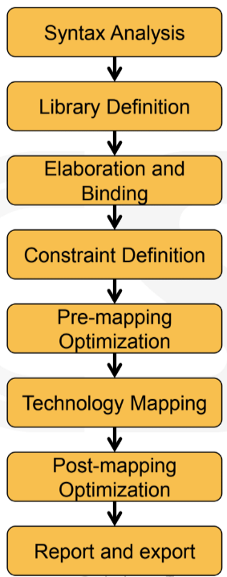
Compiler team
Synthesis db team
Compiler team
Synthesis db team (Processing SDC & UPF)
HLO team & Datapath team
Combinational & Sequential logic team
Combinational & Sequential logic team & Post map opt team

Slide 2
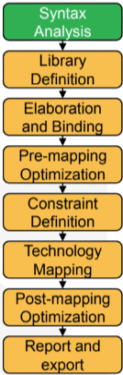
HDL parser (Verilog / System Verilog / VHDL)

Slide 3
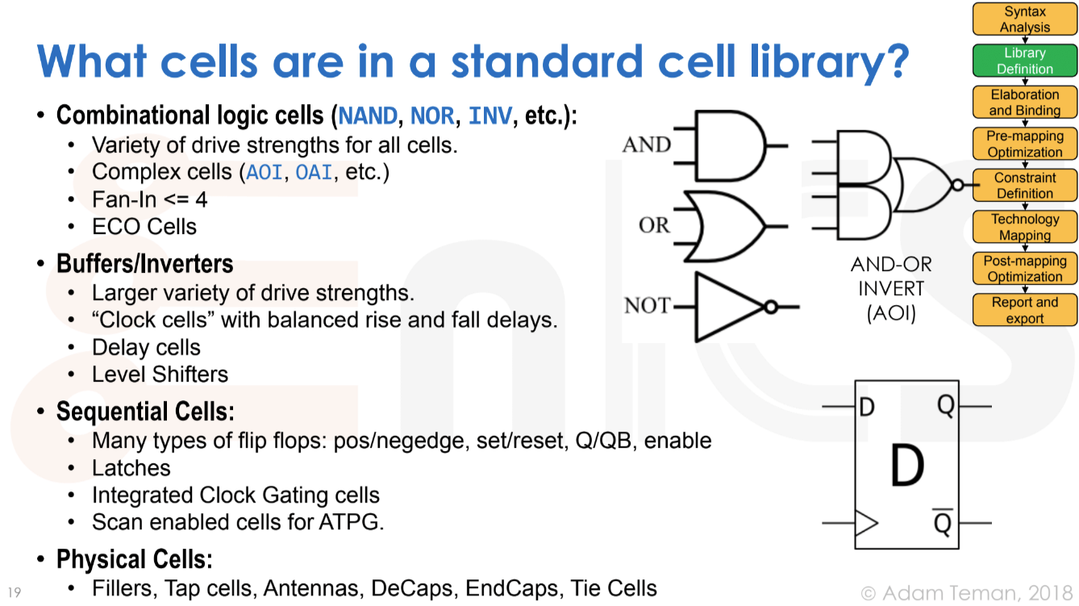

Slide 4
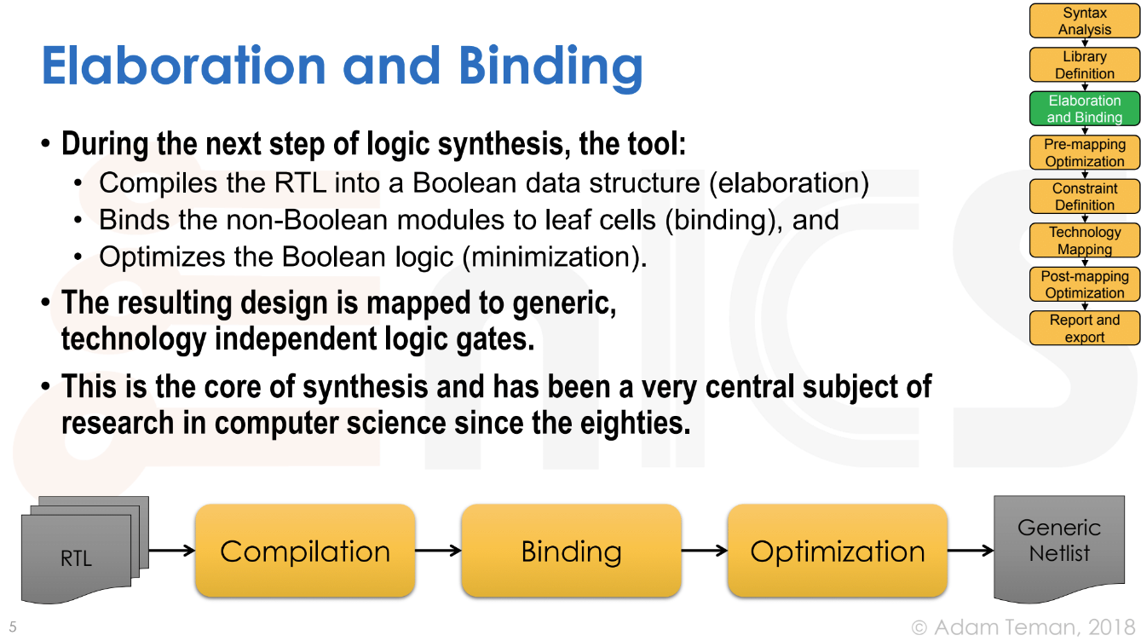

Slide 5
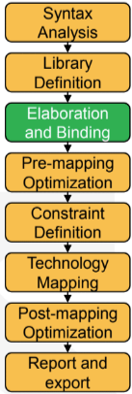
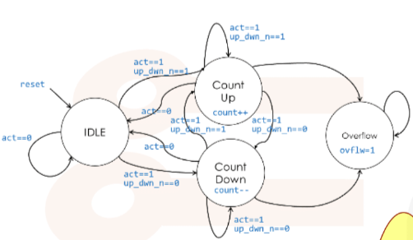
Compiler optimization (CSE, Constance propagation, etc.)
FSM optimization (Reduce register number, simplify redundant control logic

Slide 6
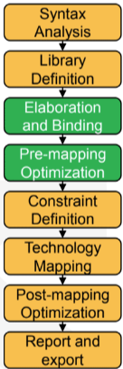
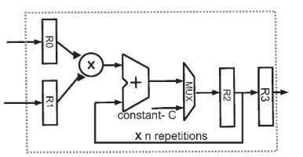
High-Level Optimization
Logic network simplification
Resource sharing
Data path extraction
Operator selection (Adder / Mux / Multiplier / …)

Slide 7
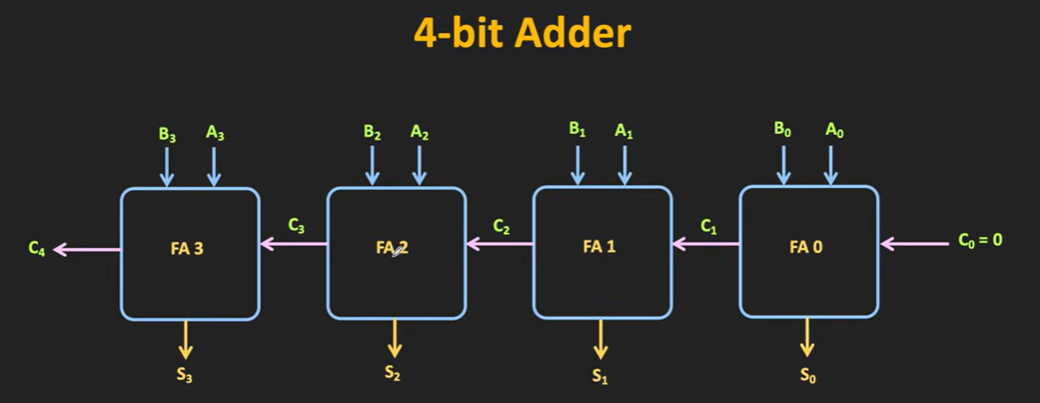
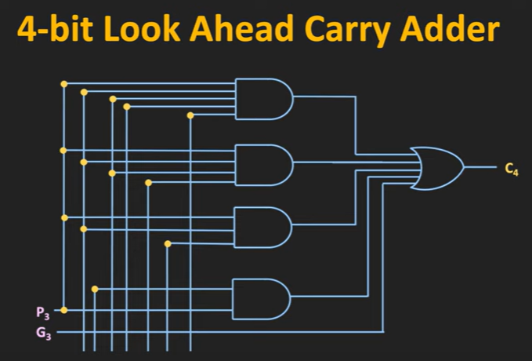
Ripple Carry Adder & Carry save adder
Wikipedia: Carry-lookahead adder

Slide 8
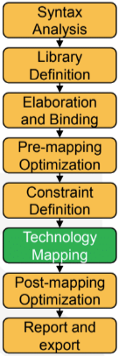
Map generic netlist to gate-level netlist
Output area minimum gate-level netlist
Timing-driven mapping
Congestion-driven mapping (Future work)

Slide 9
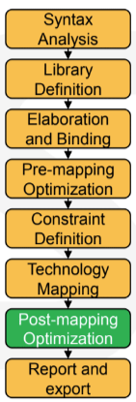
Technology dependent optimization
Power & Performance & Area (PPA)
WNS (TNS) is the top priority optimization target
Physical aware optimizations (Future work)
Routability
congestion

